Slide 1
Ethical Hacking Club Kickoff
September 2020
https://ehc.auburn.edu/
Notes:
DeMarcus

Slide 2
Leadership
President - Charles Harper
Vice President - Ethan Johnson
Treasurer - Tyler McGlawn
Secretary - Jonathan Alldridge
Public Relations Representative - Vicki McLendon
Technical Leads - Jordan Sosnowski, Zachary Leggett
Group Lead - Luke Gleba
Faculty Advisor - Dr. Tauritz
Notes:
Jordan

Slide 3
Can hacking be ethical?
YES
Notes:
Jordan

Slide 4
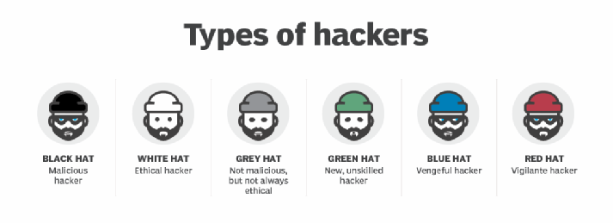

Hacker “Spectrum”
Black Hat: Malicious
White Hat: Ethical
Grey Hat: Somewhere in between
Notes:
Drew

Slide 5
How can hacking be ethical?
White hat hacker - someone who hacks only if given permission by the owner of the target
For this club, DO NOT hack, probe, prod, or analyze any system unless given explicit (preferably written) permission by the owner of the system.
Notes:
Drew

Slide 6
Why Choose Cyber Security?
Worldwide spending on cybersecurity is forecasted to reach $170.4 billion in 2022.
Only 5% of companies’ folders are properly protected, on average.
Security breaches have increased by 11% since 2018 and 67% since 2014.
Damage related to cybercrime is projected to hit $6 trillion annually by 2021.
By 2021, it’s projected that there will be 3.5 million unfilled cybersecurity jobs globally.
The cybersecurity unemployment rate is 0% and is projected to remain there through 2021.
https://www.varonis.com/blog/cybersecurity-statistics/
Notes:
Charlie

Slide 7

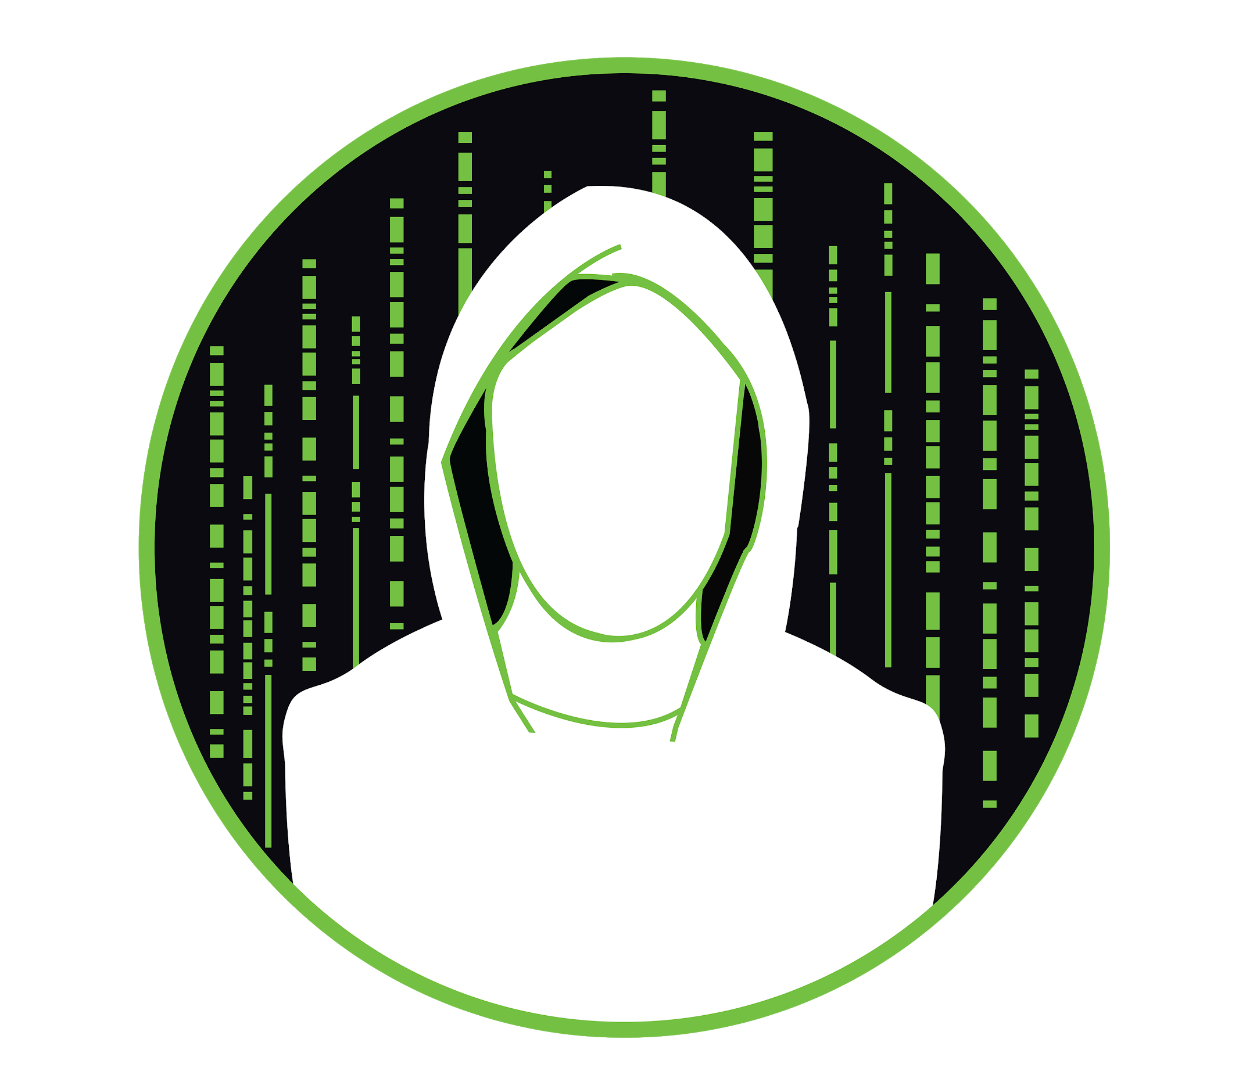

What we do
Weekly meetings focused on varying cybersecurity topics
Cybersecurity focused projects
Monthly “Capture the Flag” competitions
Organize AUCTF 2021, Auburn’s own CTF
Trip to DEFCON, premier hacking convention in Las Vegas
Notes:
Charlie

Slide 8
Weekly Meetings
Each topic will will span for one or multiple weeks and each week we will delve into different components of that topic
Meetings are 2 hours long
1st Hour: Lecture Oriented
2nd Hour: Lab Oriented
The first fifteen minutes each week will be set aside for talks by club members, sponsors, or faculty
Anything goes, talks on programming languages, hacking methodologies, toolkits, conferences, internships, etc.
Notes:
DeMarcus

Slide 9
What if I Cannot Make It?
Links to our slide decks will be posted on our Discord server and website
Meetings will be documented on our website
We are looking into recording parts of our meeting and having those be available as well.

Slide 10




Topic Schedule for the Fall Semester
CyberSecurity Bootcamp
A high level overview of the wide spectrum of subtopics cybersecurity can include
Open Source Intelligence (OSINT)
Social Media, Google Dorking, browser add-ons, etc.
Web Application Hacking
OWASP Juice Shop, DVWA, Web GOAT, etc.
Network Analysis
PCAP Analysis, WireShark
Cryptography
Encryption Algorithms, Hashing Algorithms
Pentesting
Try Hack Me, HackTheBox, Metasploitable, etc.

Slide 11






Weekly Talks
Start of each meeting
10 - 15 minutes long
Can be on anything related to cybersecurity or computing
Languages
Python
Rust
Research Opportunities
Tools
Hashcat
Processes
Buffer overflow
OS / Distros
Kali
Parrot
Notes:
Jordan

Slide 12


Potential Club Projects
Building an Elastic Stack
Mapping Auburn WiFi APs through War Driving
Building/managing AUCTF 2021
Building/maintaining our lab environment
Building a new and improved EHC website
Building infrastructure for attack-defense exercises
Interest in Research Opportunities
Passive Network Scanning
Connecting with Professors

Slide 13



Monthly CTFs
CTF Time (https://ctftime.org)
Cybersecurity Puzzles
September
DownUnderCTF
October
b01lers CTF
November
DOE CyberForce
Notes:
Charlie

Slide 14
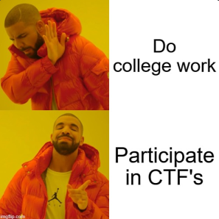
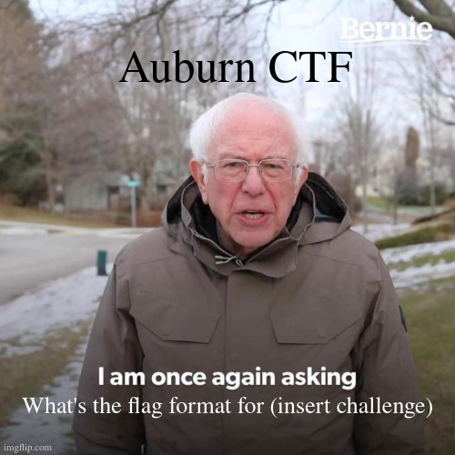
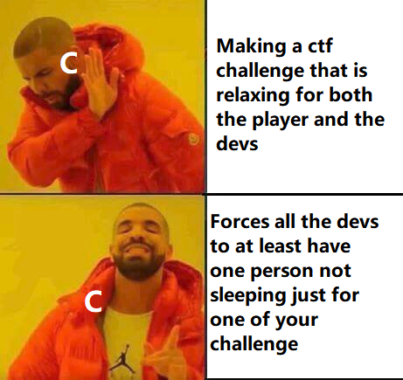
AUCTF 2021
Tentatively Scheduled for the end of April/beginning of May
Prizes are still TBD
Categories include but are not limited to: Reverse Engineering, Forensics, Web, Bash, Signals
Regular club attendance and participation in events will help you prepare for the event

Slide 15


Discord
Survey
https://aub.ie/ehc-discord
https://aub.ie/2020fall_kickoff_survey
Notes:
Jordan

Slide 16

Questions?

Slide 17
Competition
VPN to auvpn.auburn.edu from cisco anyconnect
Go to mockctf.auburn.edu and create an account
Only the Kickoff category counts towards the competition
The competition will end at exactly 7:00 PM
Winners will be announced shortly after in the general zoom room
If you need technical help go to the tech help breakout room
If you do not know anything about linux go to the the bash intro breakout room
Good Luck!

